Slide 1
Visual Ethnography
Hilary coombs
A day at the Bull Sales
1 February 2026

Slide 2
Part 1
Preparation

Slide 3
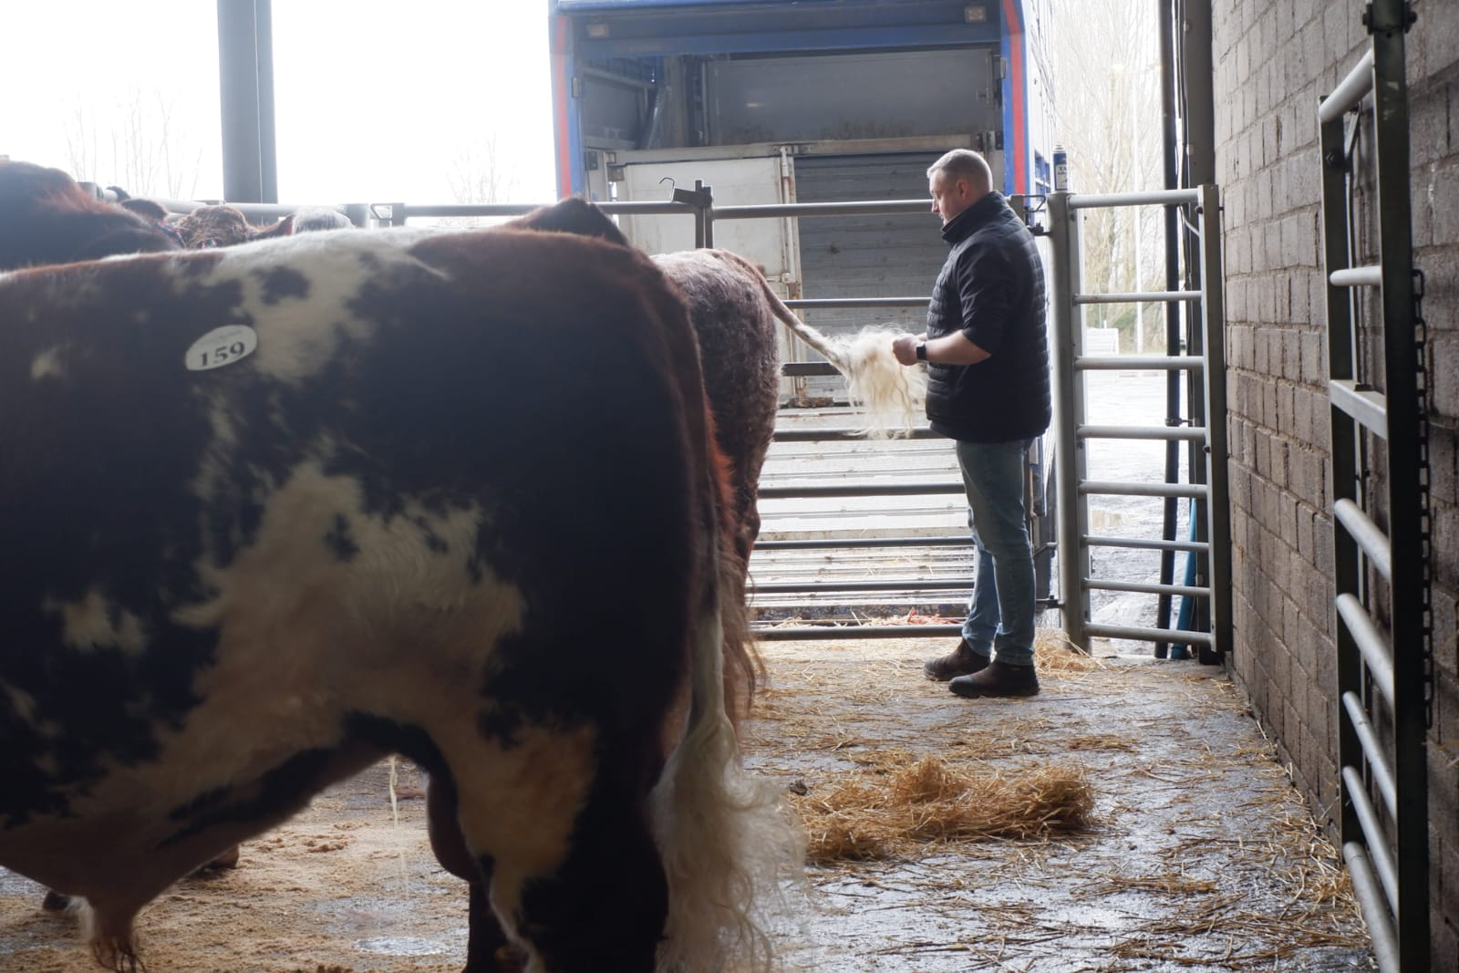
After weeks or months of preparation, the animals arrived at the mart the day before the show. They will all be bathed and groomed repeatedly before they enter the ring.

Slide 4
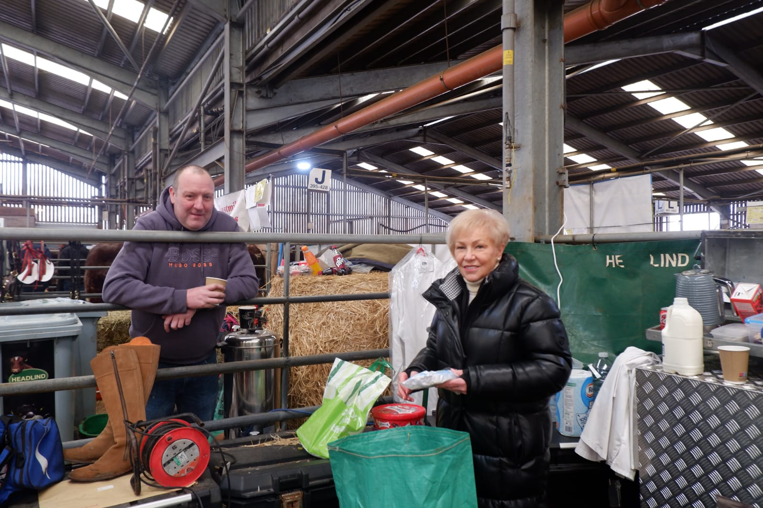
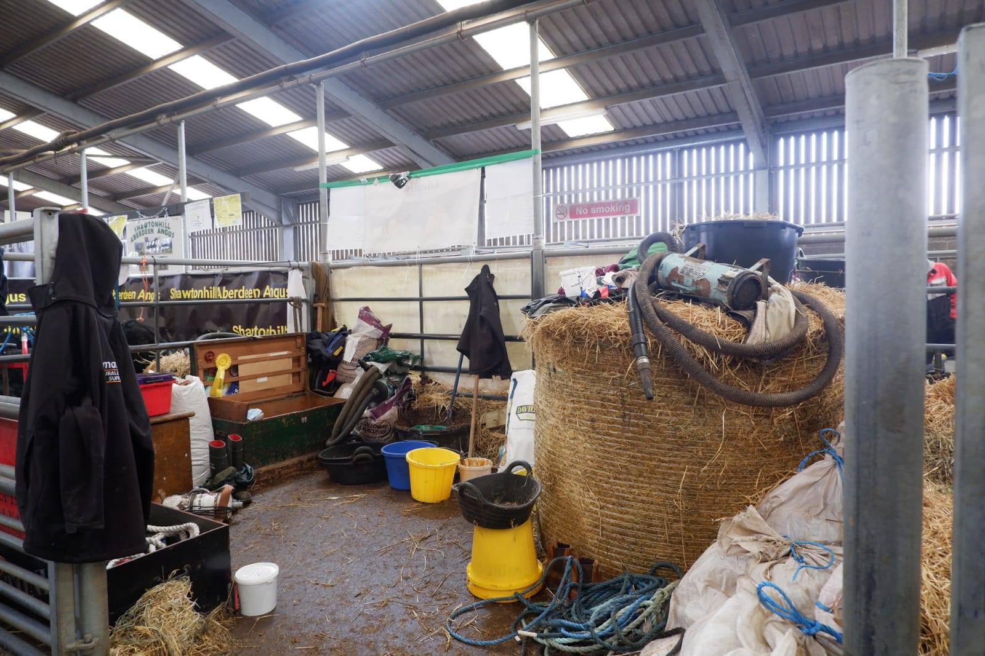
Each herd sets up camp near their animals for the three days they are here.

Slide 5
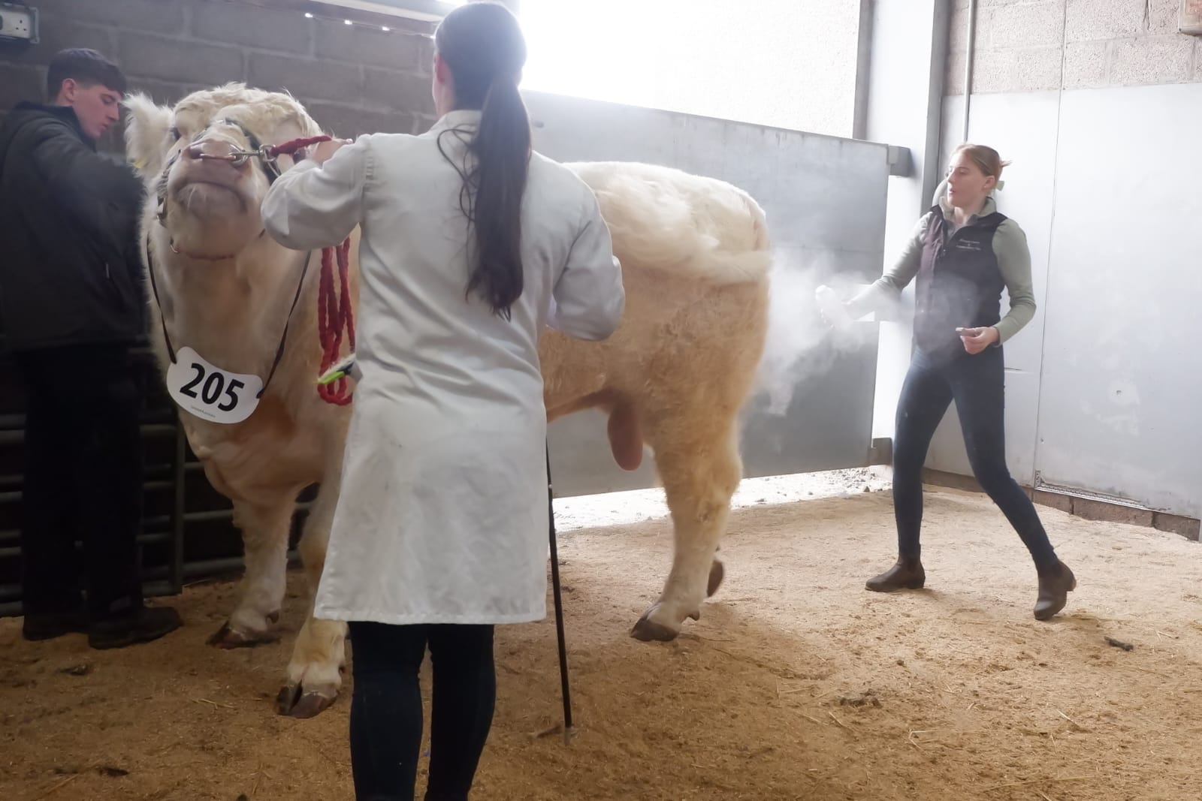
White Beef Shorhorn bulls are not so popular, unless required to produce roan calves from out of a red cow, but if they are white must be as white as possible.

Slide 6
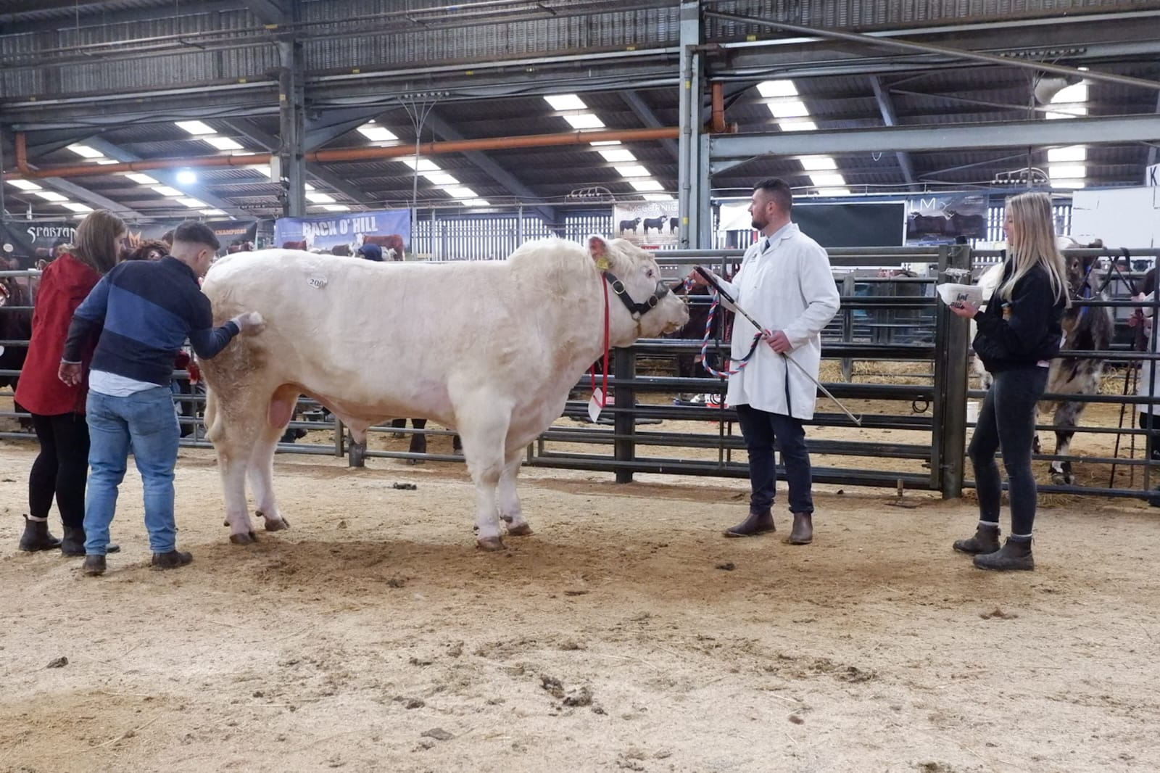
An entire family can be involved in preparation of the bull.

Slide 7
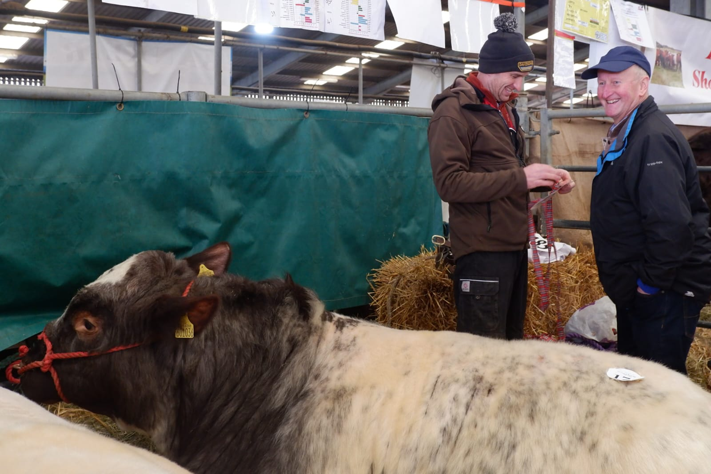
Owners stay around the pens in case old acquaintances or potential buyers drop in.

Slide 8
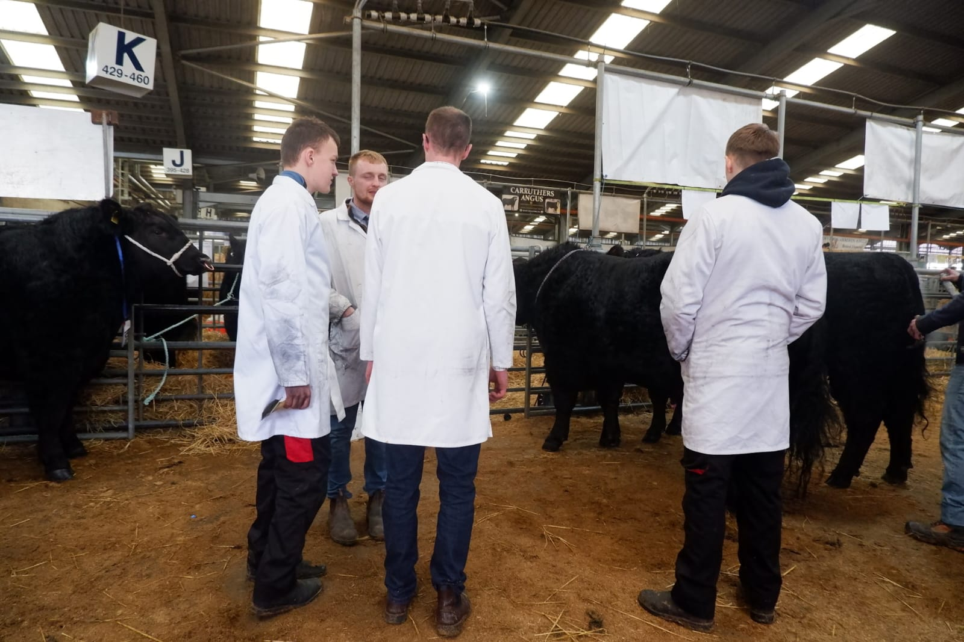
In the collecting area, these may be professional handlers contracted to turn out and show the bulls or they may be young farmers catching up.

Slide 9
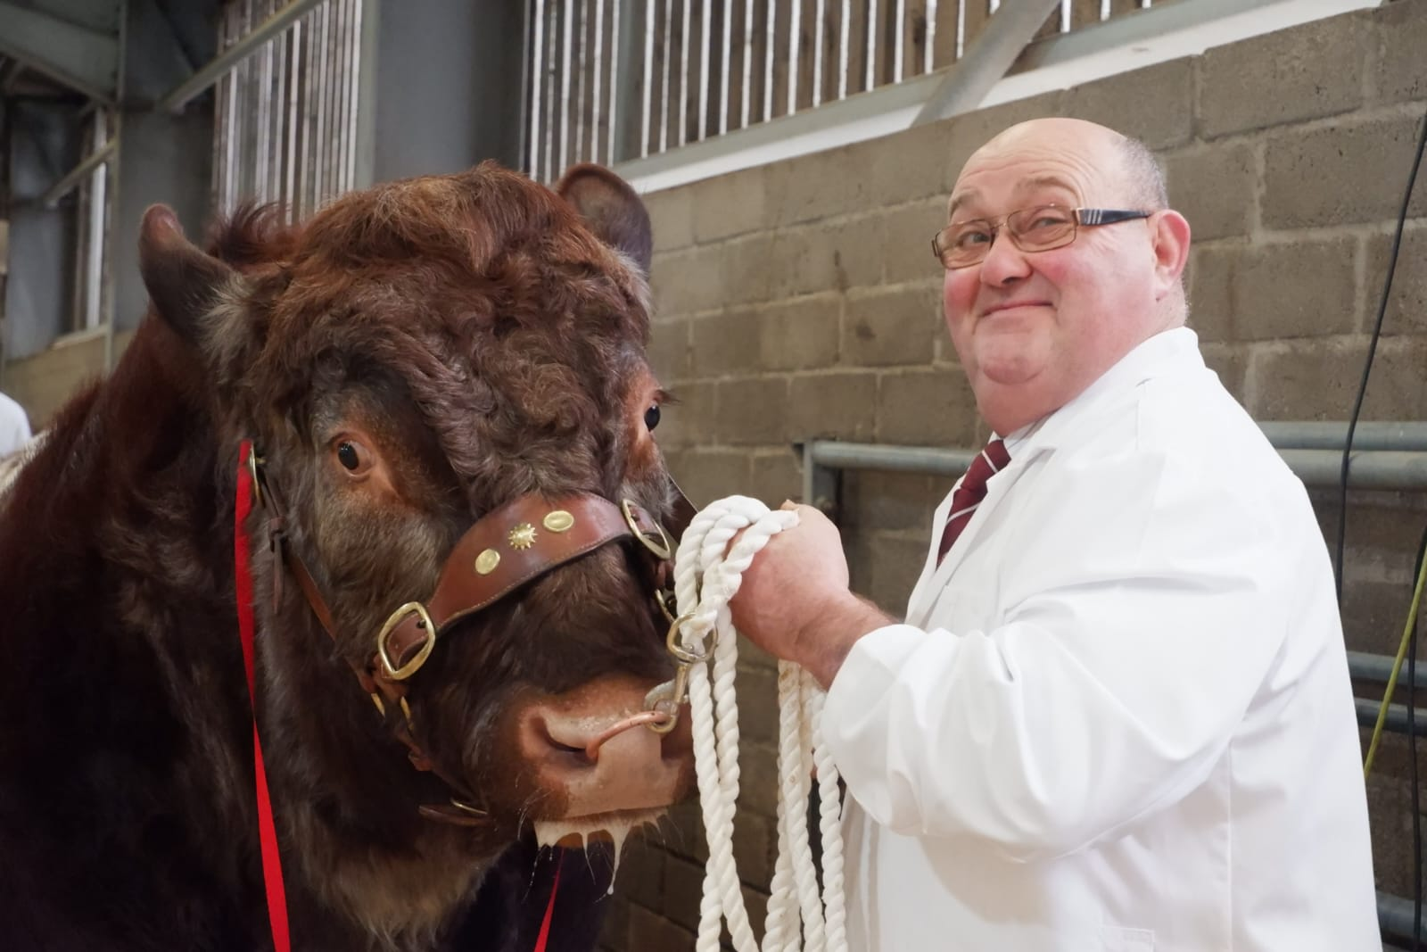
The breeders of the bulls are mostly long established and come every year but there are usually some newcomers too. This handler is a stockman and he has been coming to the Bulls Sales every year for as long a anyone remembers.

Slide 10
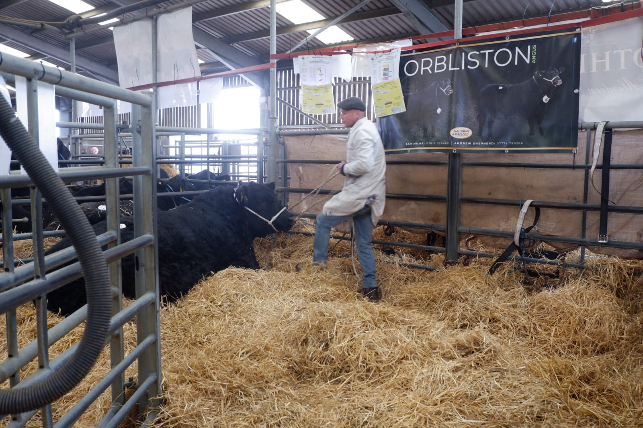
Bulls mostly lie down. It’s time for this one to head to the ring.

Slide 11
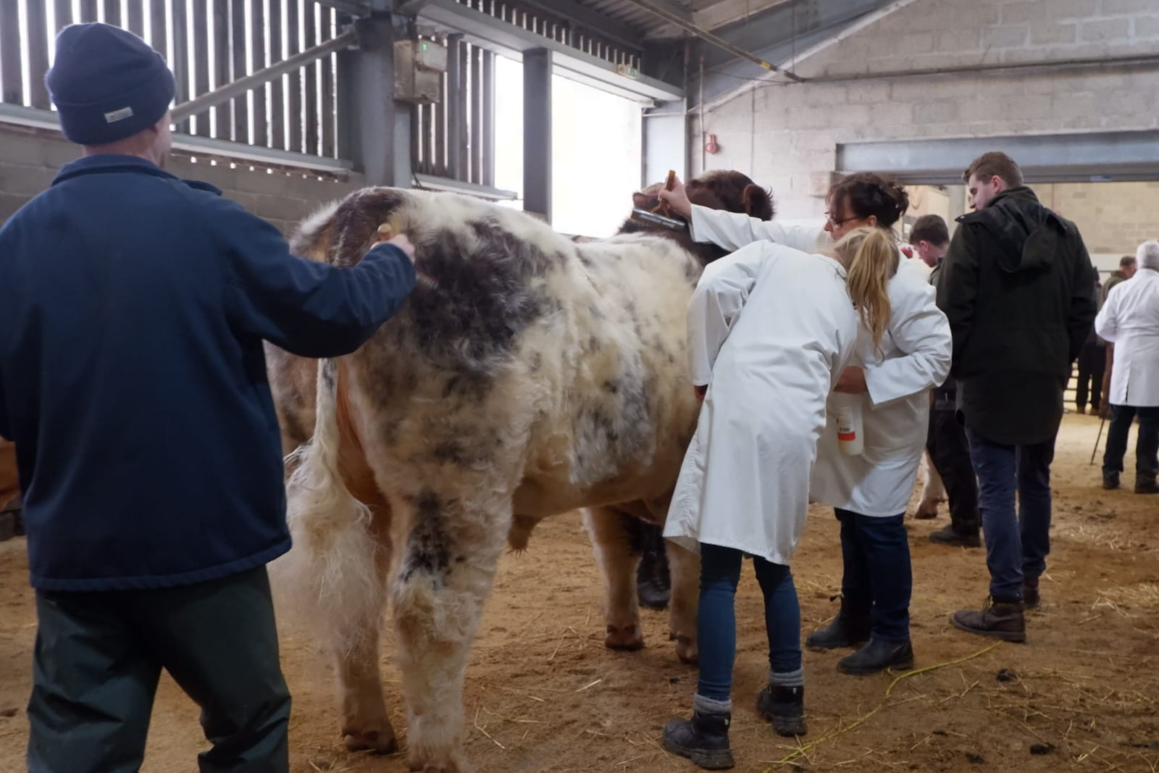
Every bull is tidied up again immediately before entering the show ring.

Slide 12
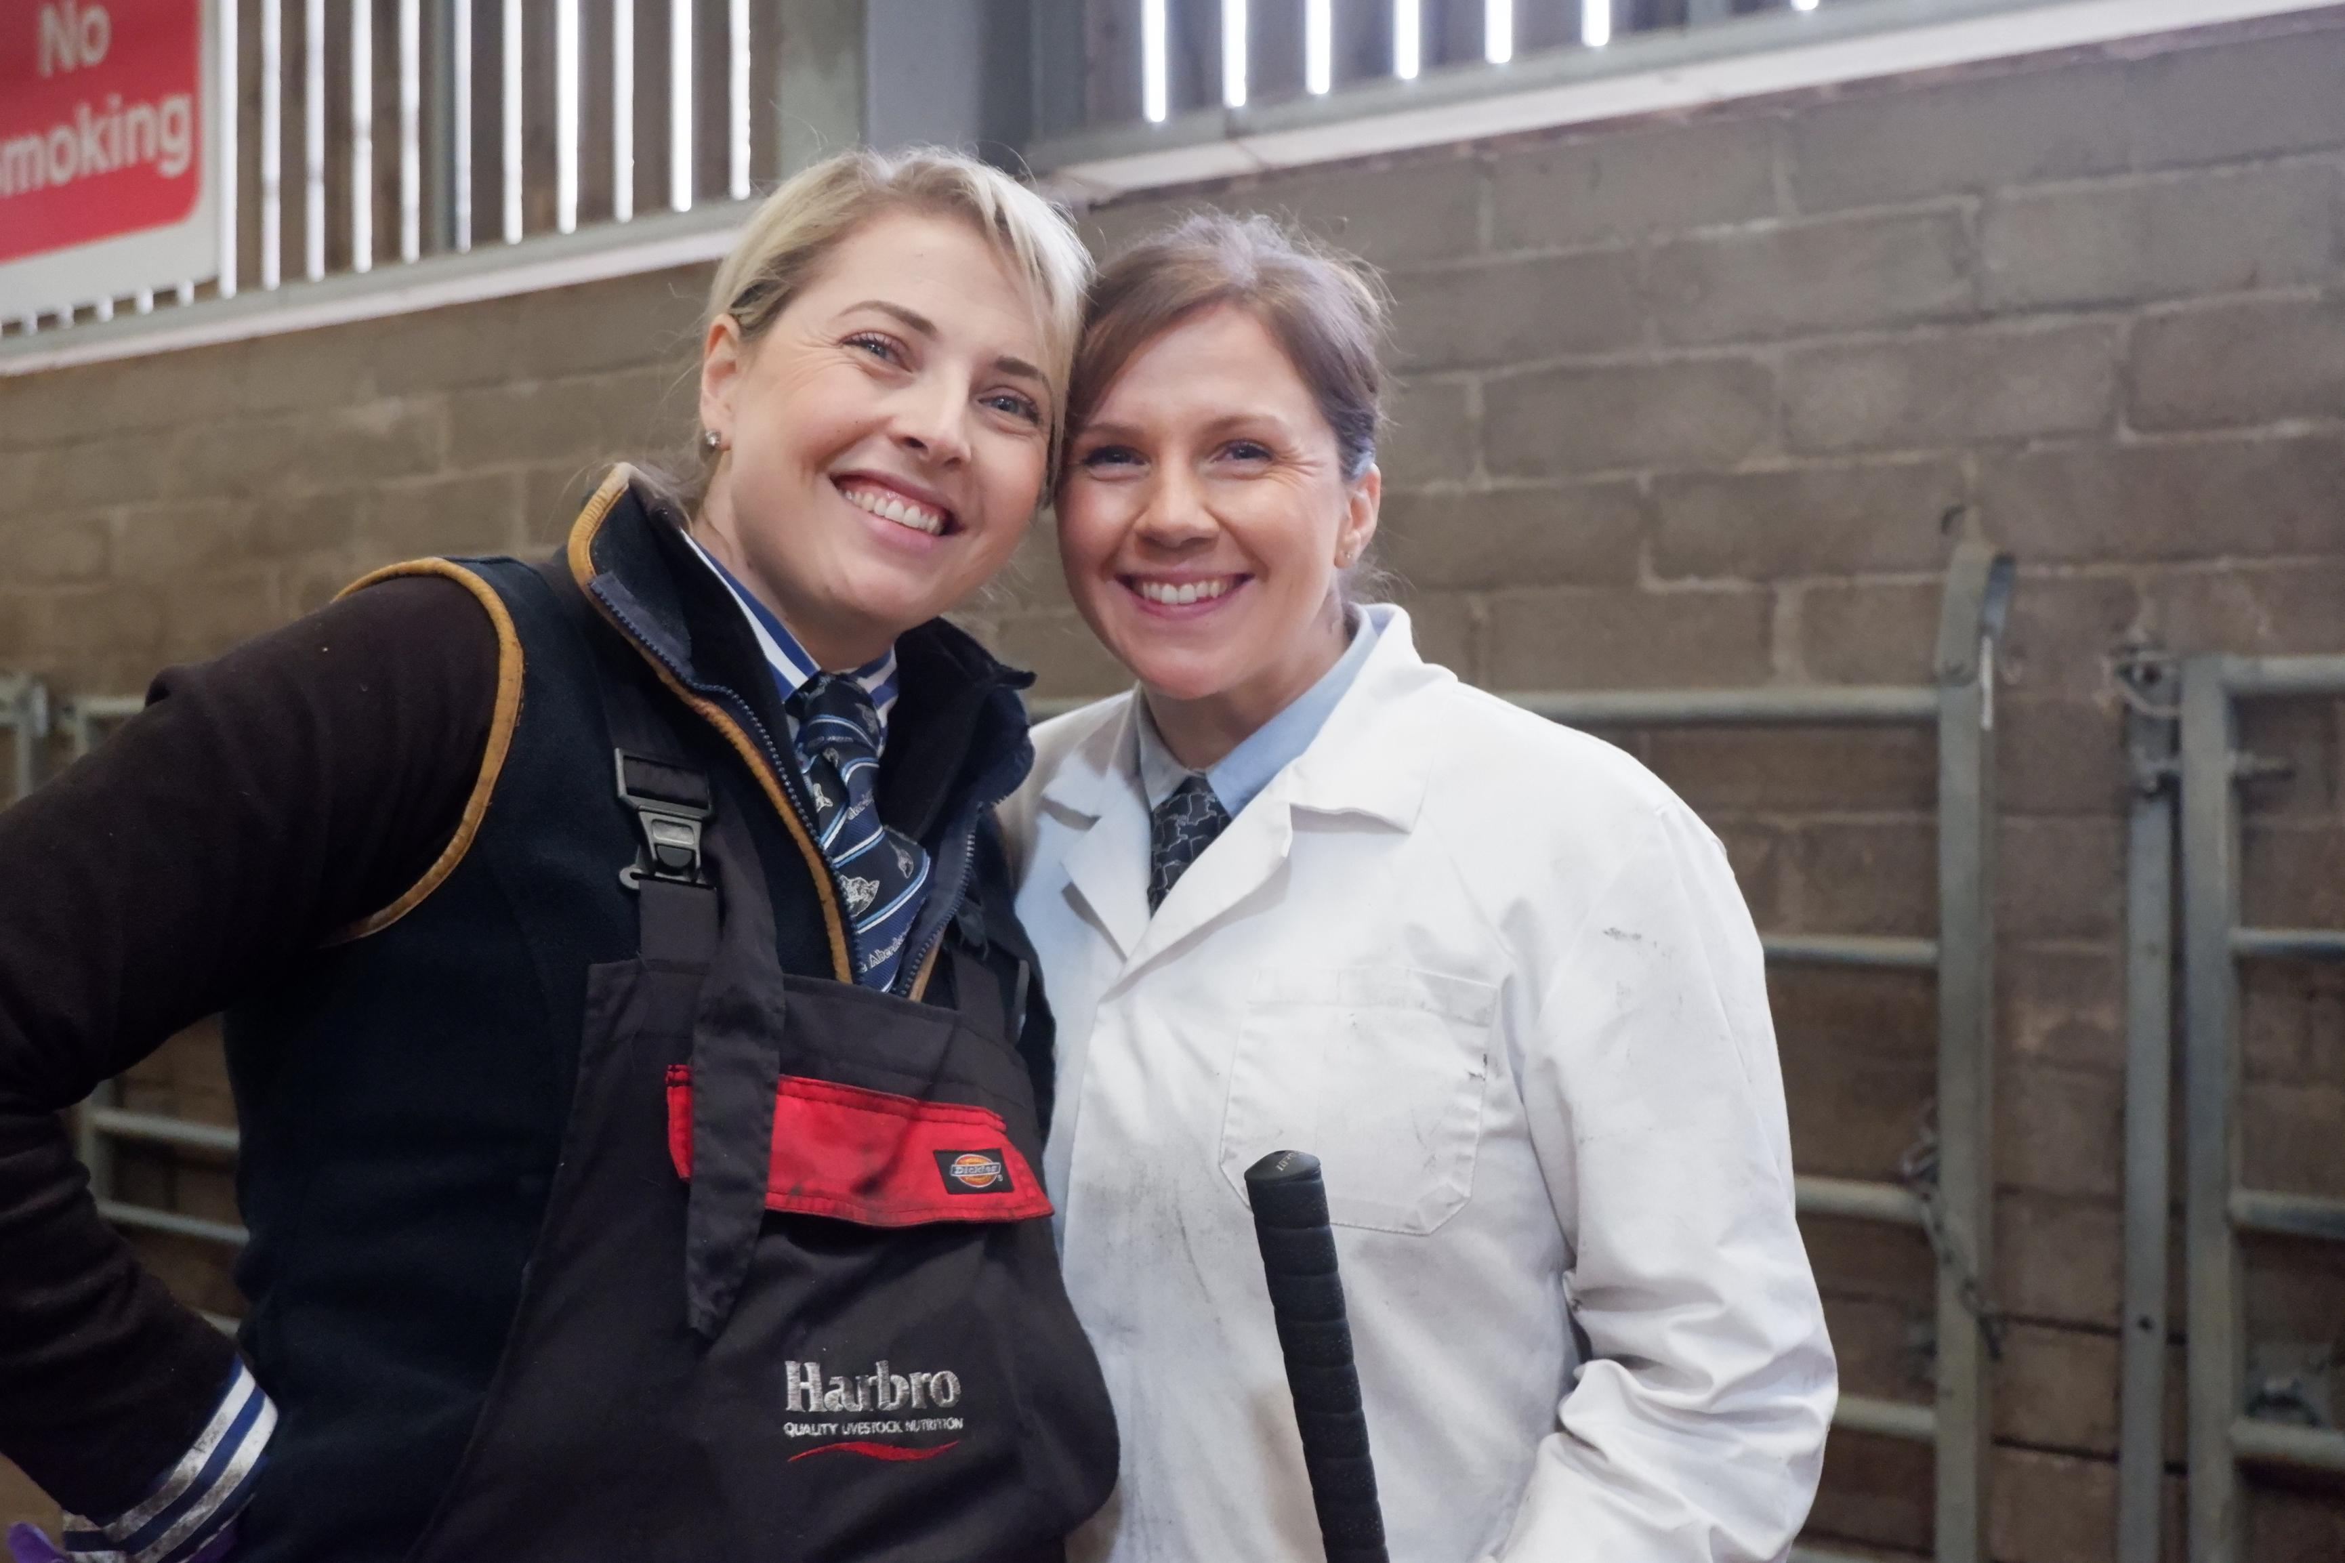
Every person appearing in the ring wears the tie of their breed society. These women are wearing the ties of the Aberdeen Angus breed society.

Slide 13
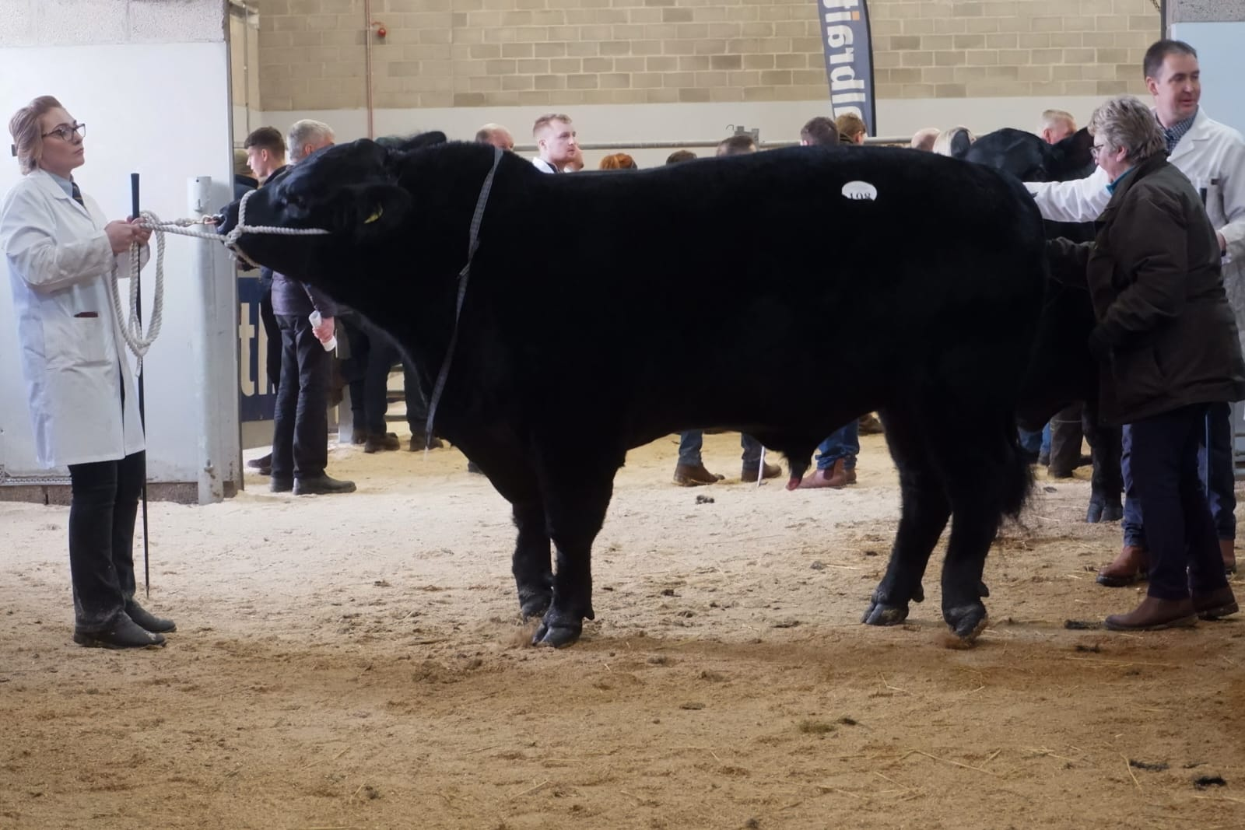
Moments to go before the first class of bulls enters the show ring.

Slide 14
Part 2
The Show

Slide 15
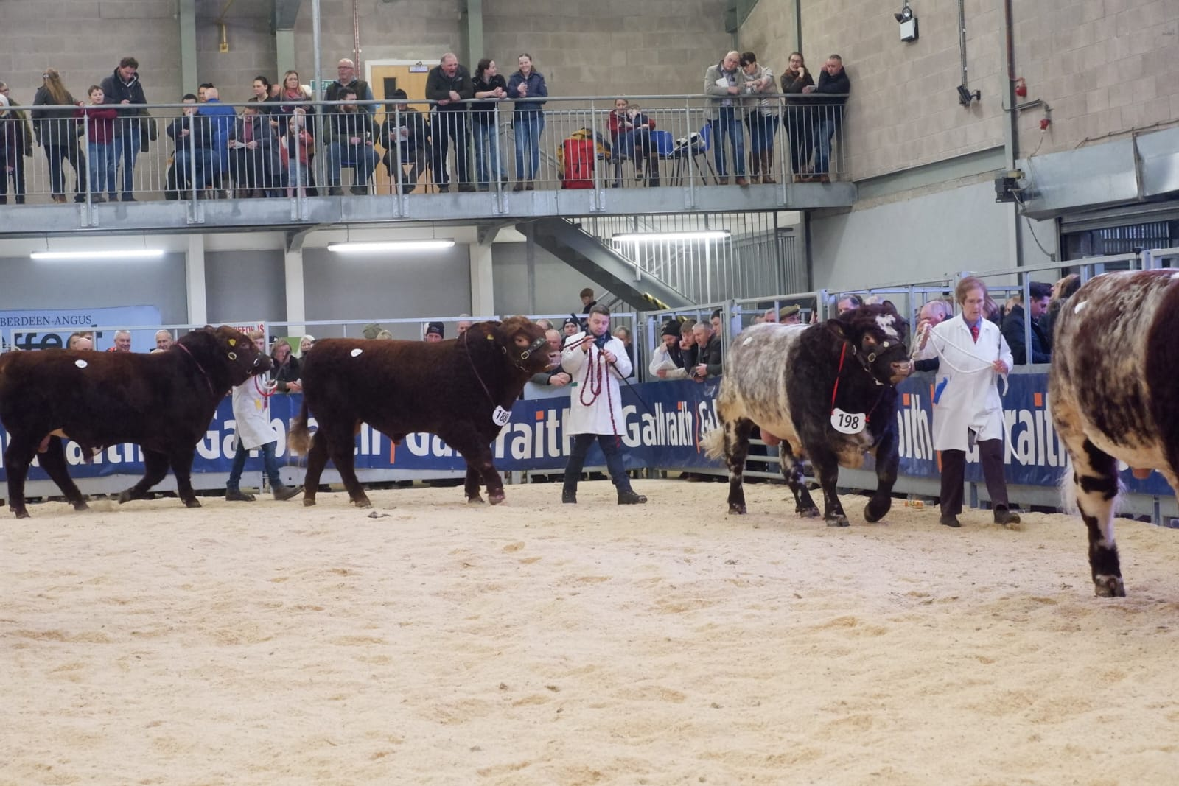
The bulls are paraded round the ring so the judge can see them walking to check if they’re sound. He is also getting his eye in.

Slide 16
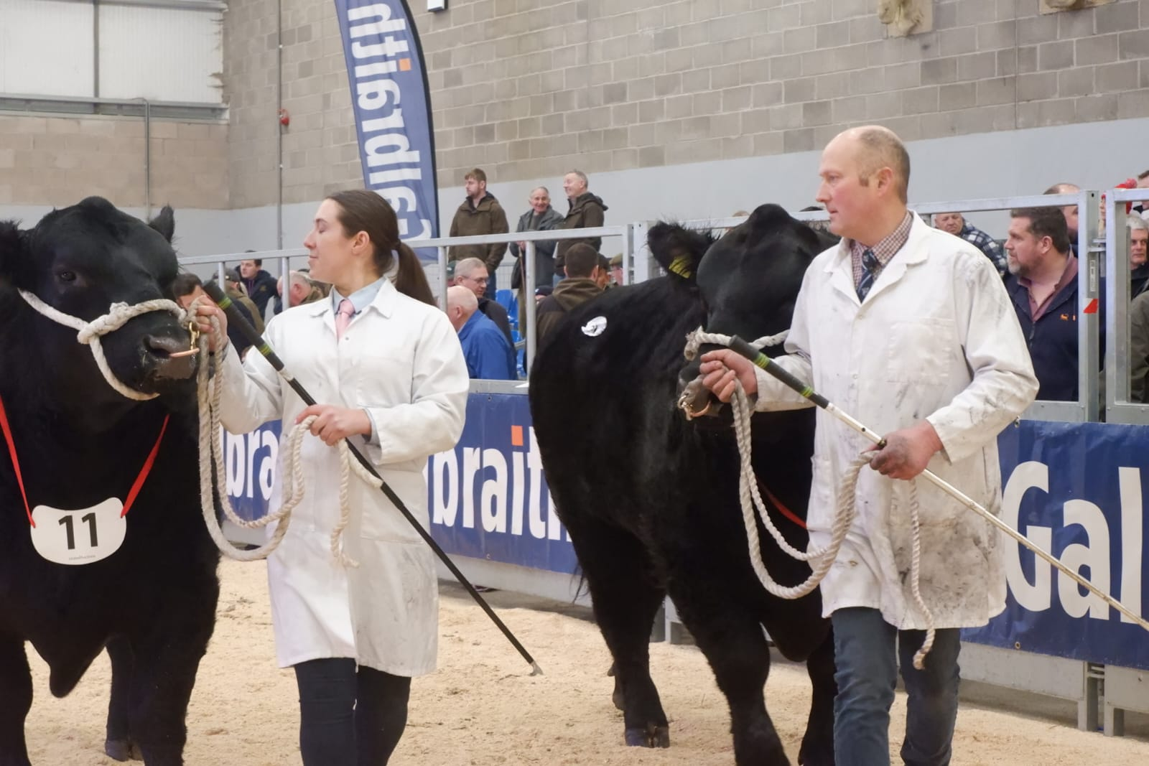
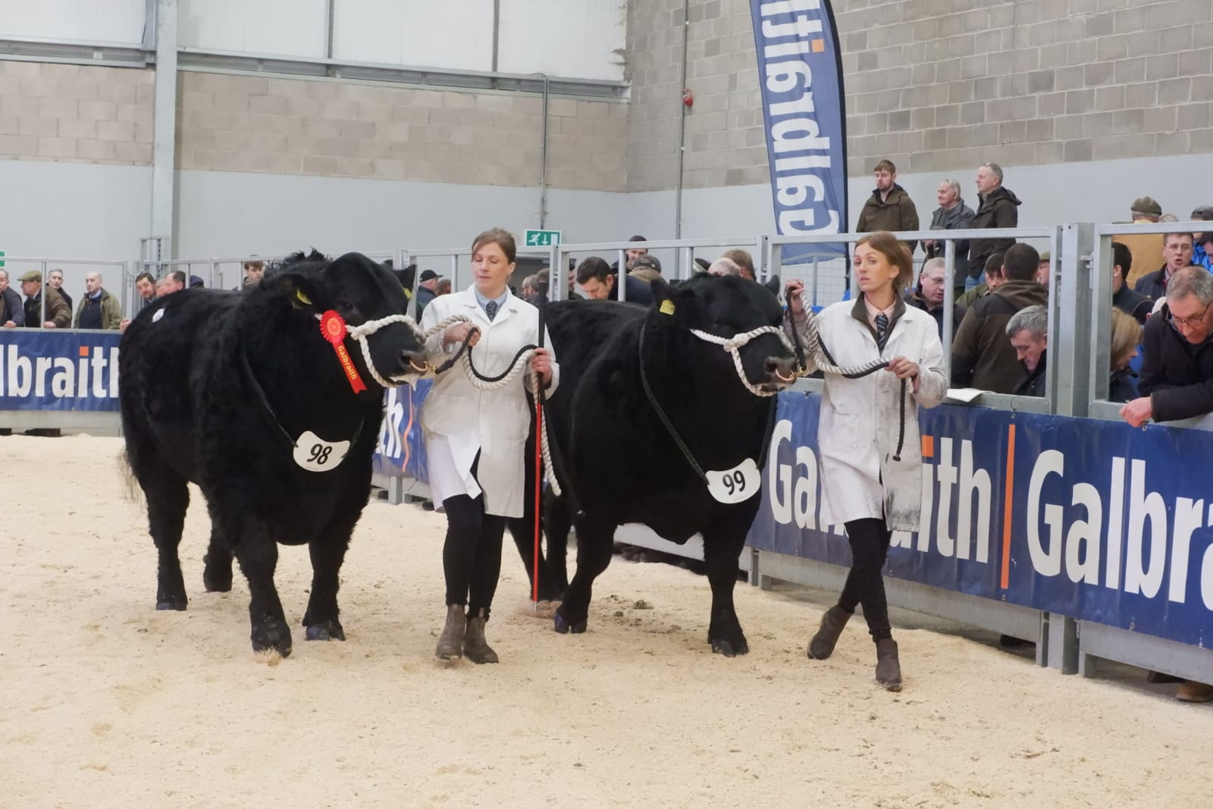
These handlers are professionals, preparing and showing the animals on behalf of the breeder/owners. Sometimes they are paid to look after the bulls for several months before the show, to halter train and get them in ‘show condition’.

Slide 17
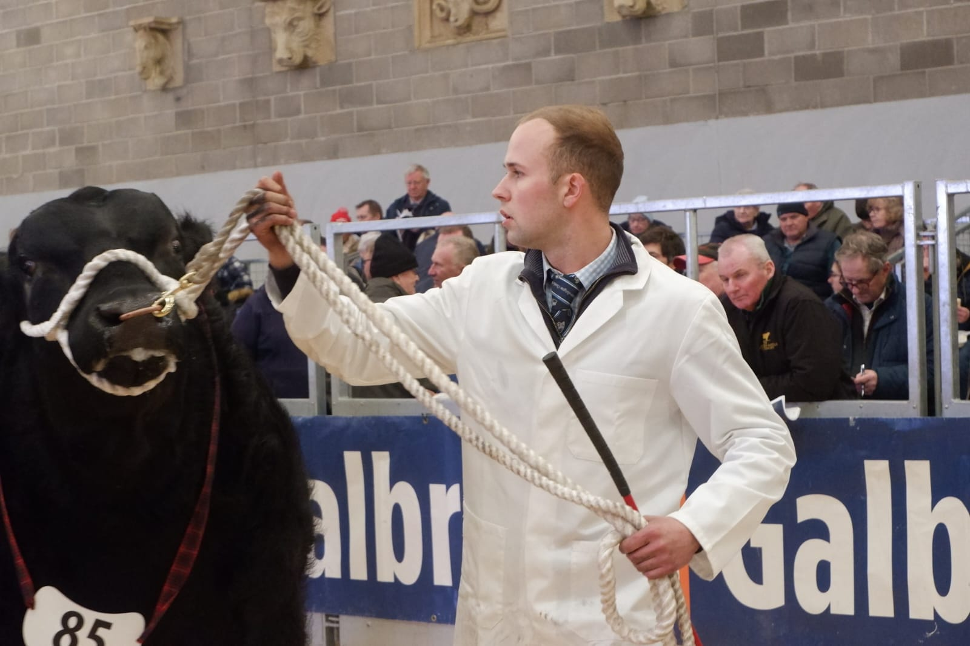
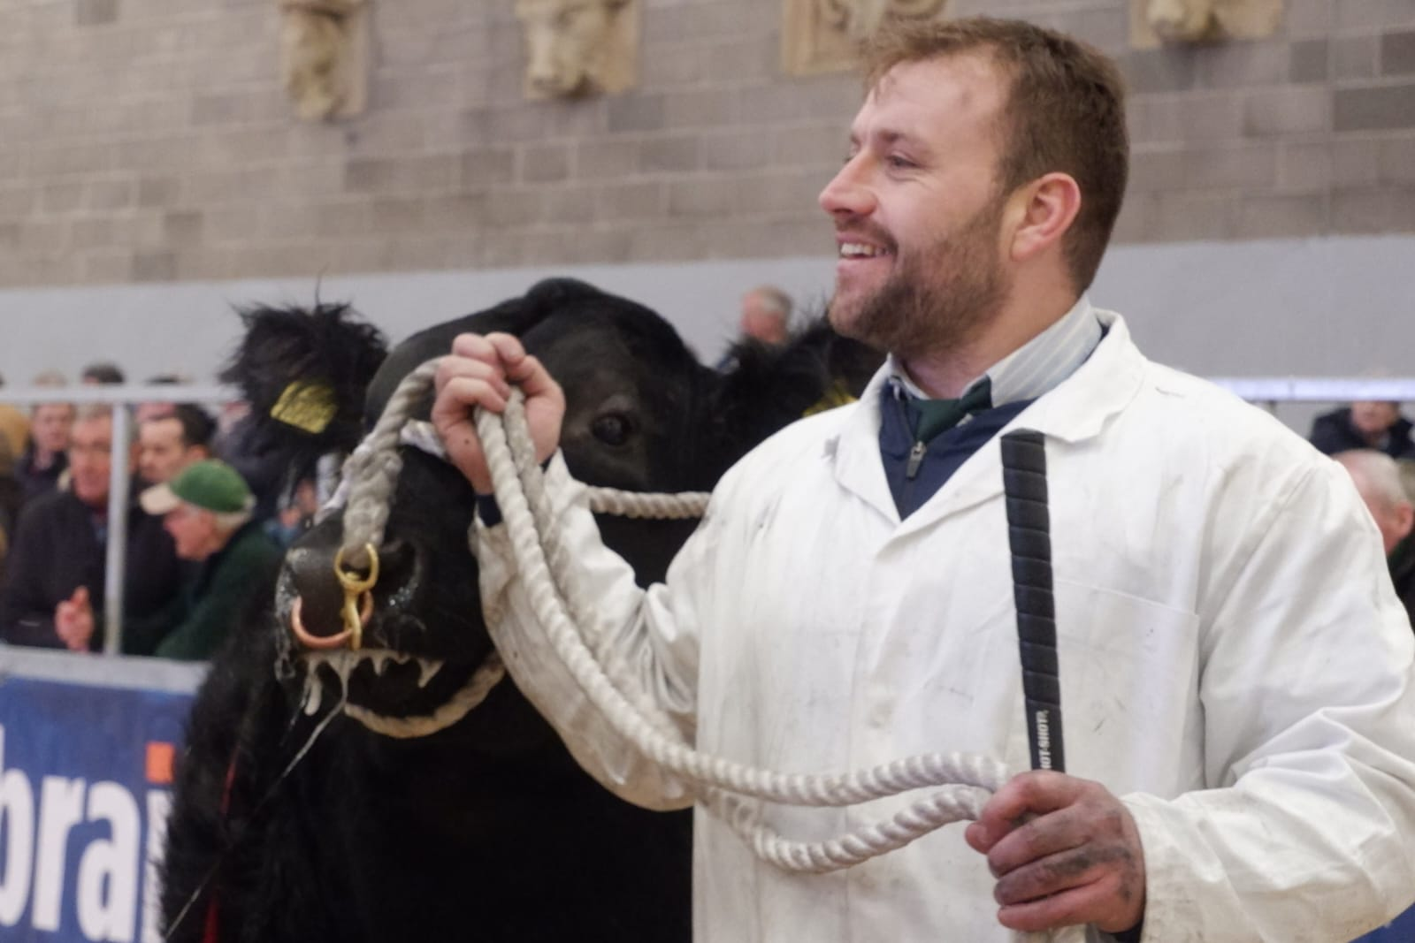
The handlers are trying to keep the bull’s head up to show him to best advantage

Slide 18
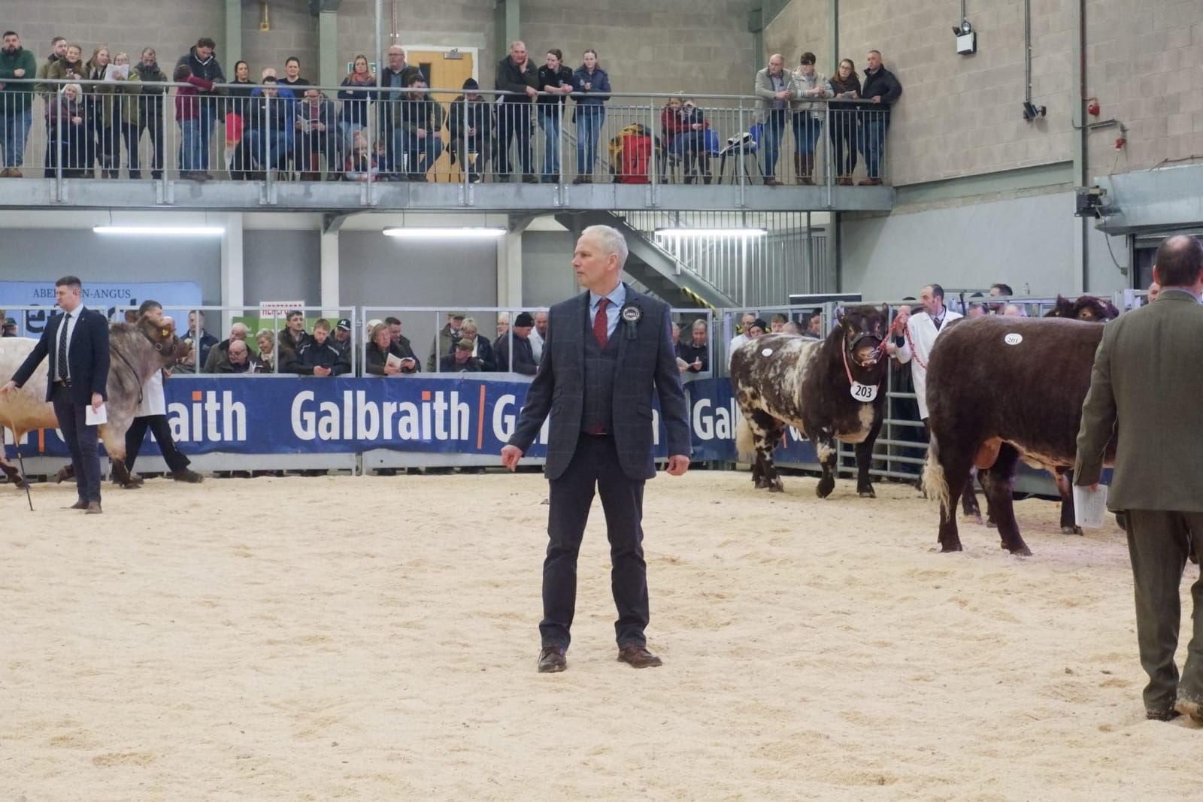
As the bulls parade, the judge is deciding who he is going to pull into the line and in what order.

Slide 19
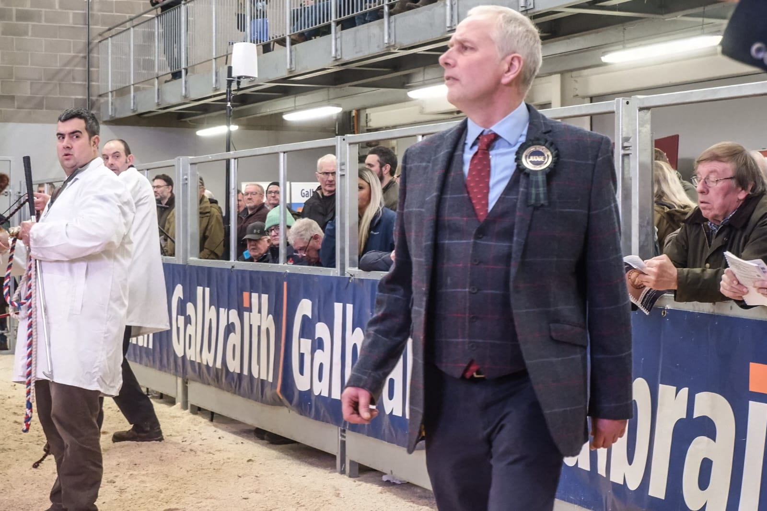
The judge walks backwards and forwards throughout, covering a lot of ground, while he makes his initial selections.

Slide 20
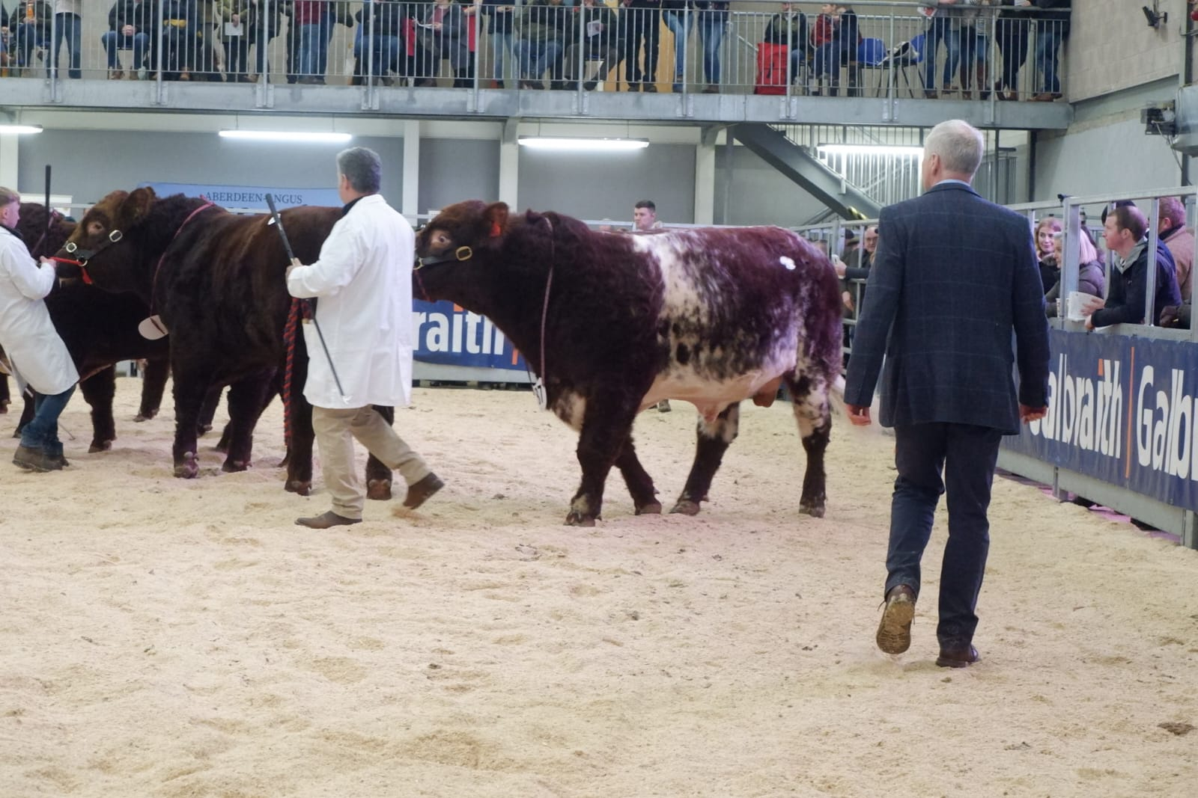
Competitors are beginning to pull in their bulls to be lined up for closer inspection

Slide 21
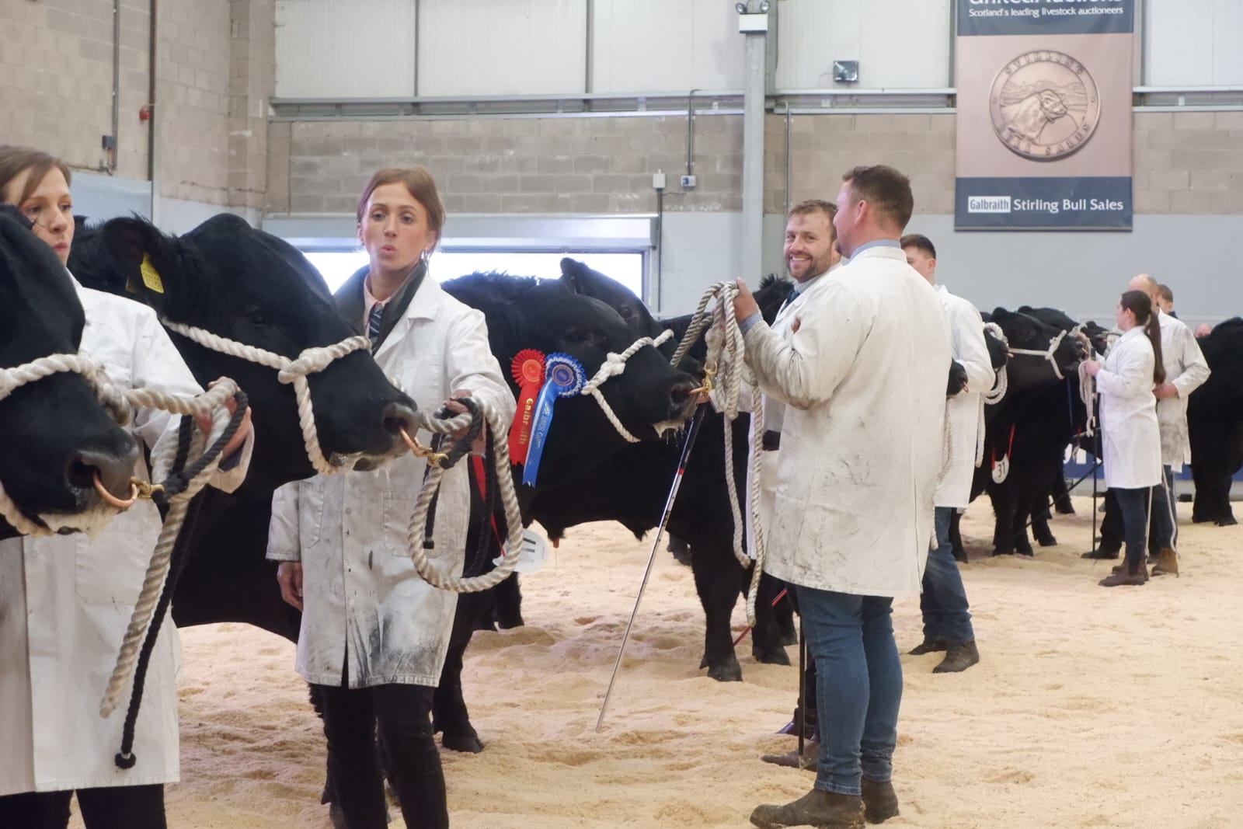
The bulls stand in line the the order they were pulled in by the judge. He will spend time looking at each of them. The handlers keep showing them off in case the judge glances at them.

Slide 22
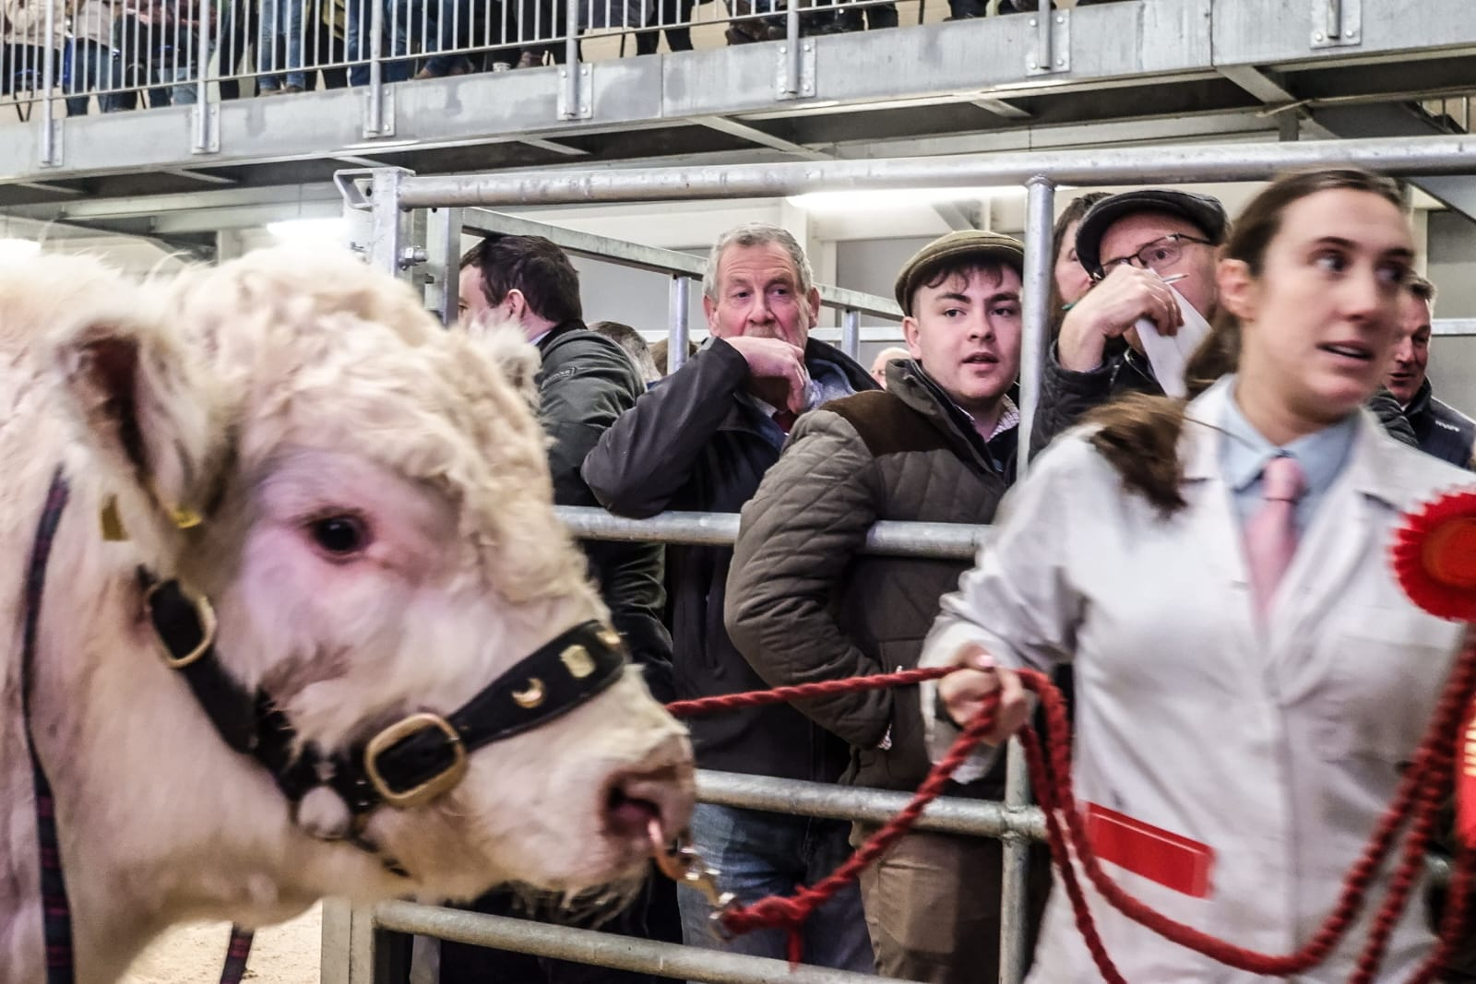
The spectators can come very close to the bulls in the ring if they stand at the entry and exit gates. This gate is where they will exit..

Slide 23
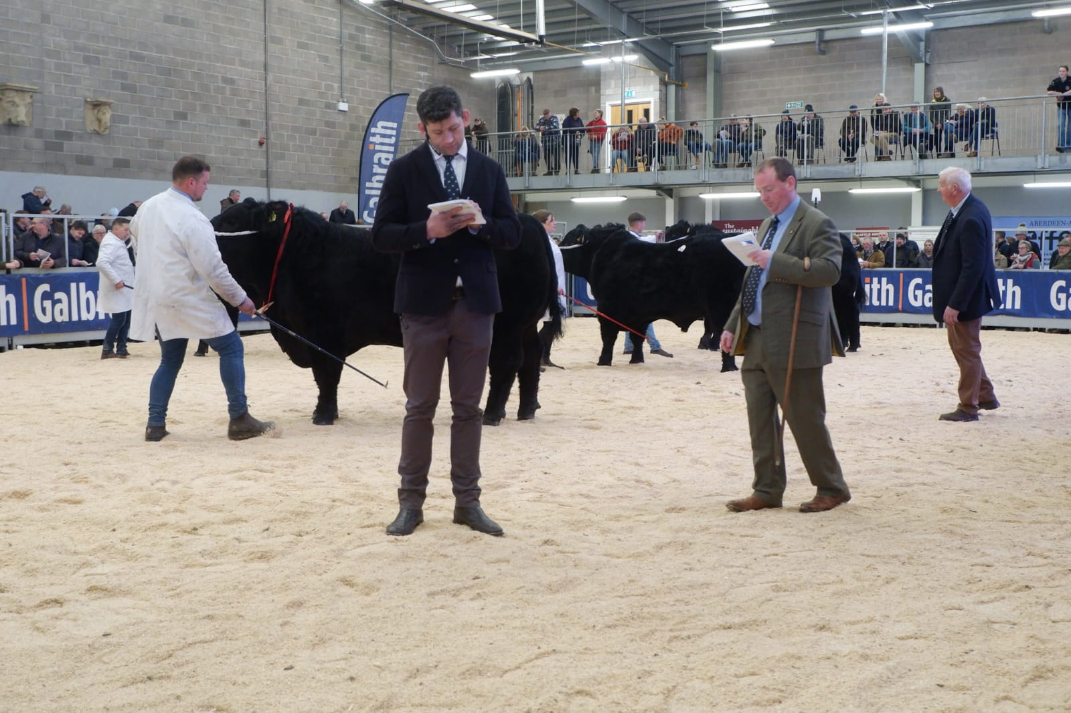
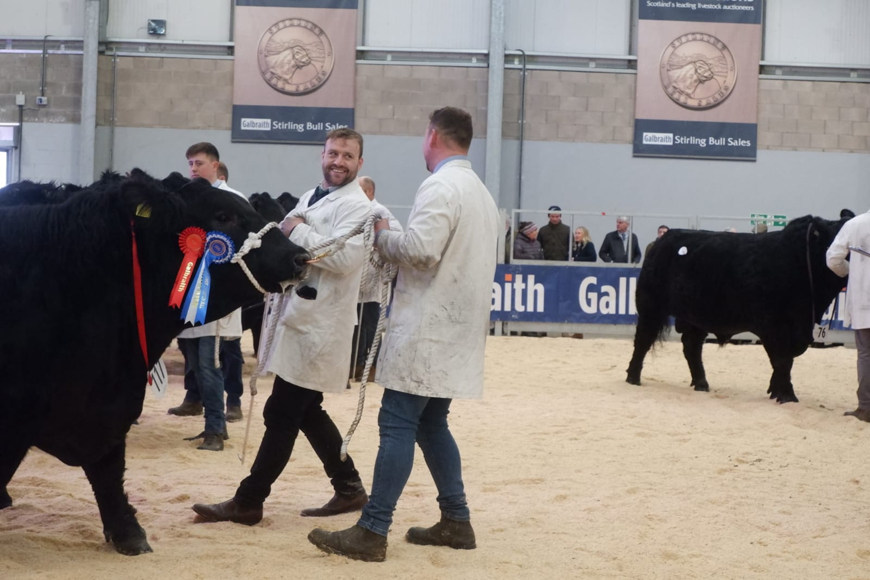
The judge is starting to inspect more closely the Angus bulls he has signalled to bring into the line.

Slide 24
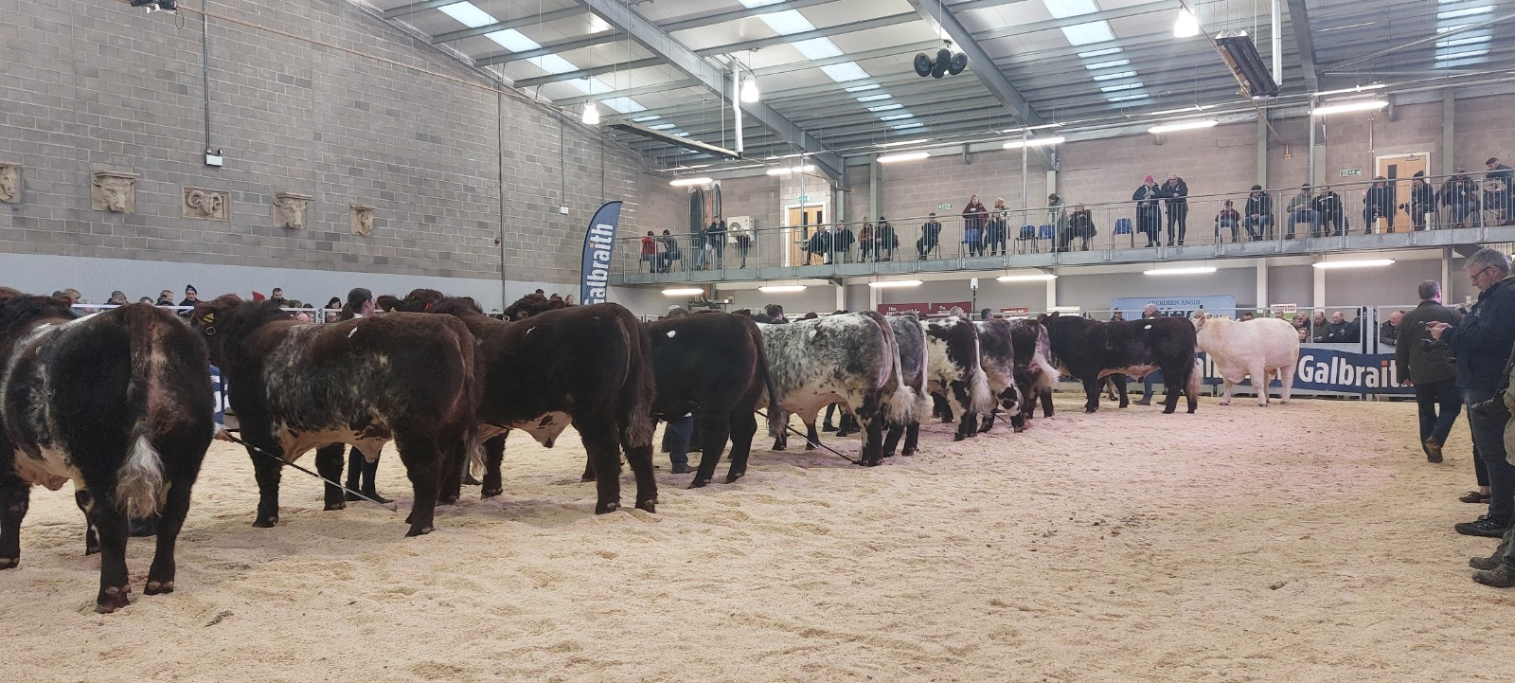
The Beef Shorthorns wait in line for the judge to inspect them. He may touch them or have them walked again by the handler or he may throw them out.

Slide 25
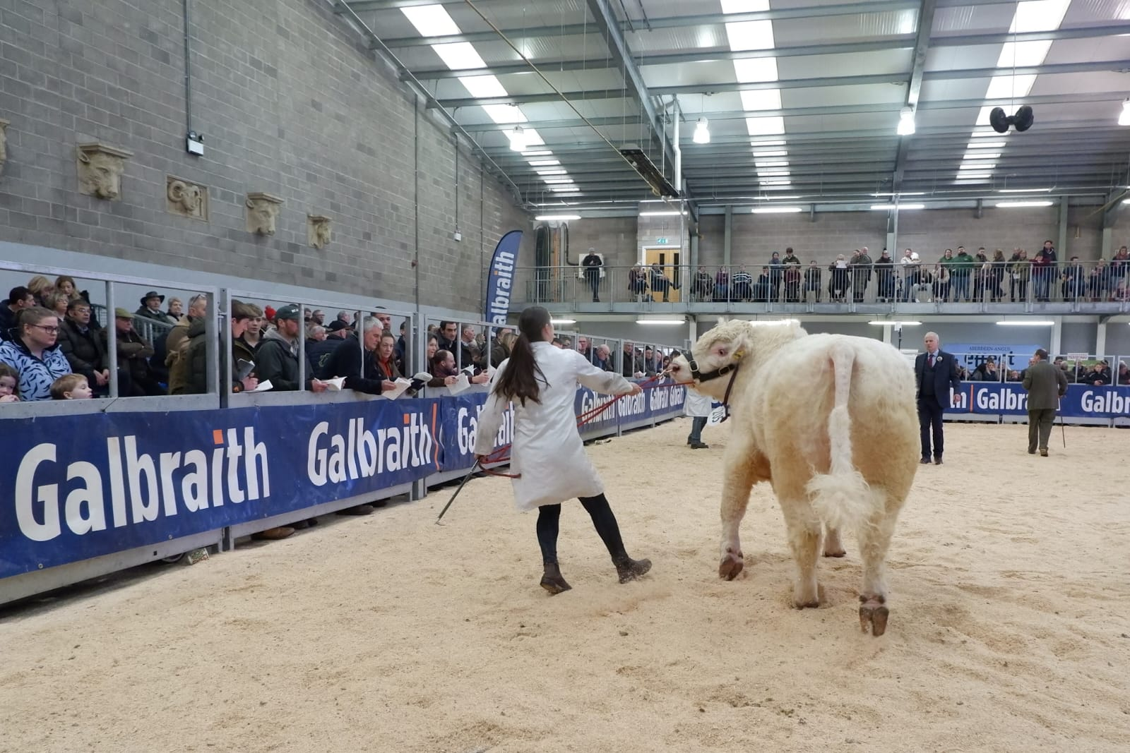
This Beef Shorthorn bull has the disadvantage of being white but his behaviour in the ring might also put off buyers and could indicate a poor temperament to pass on to his calves. Occasionally, a bull will run out of the ring dragging the handler.

Slide 26
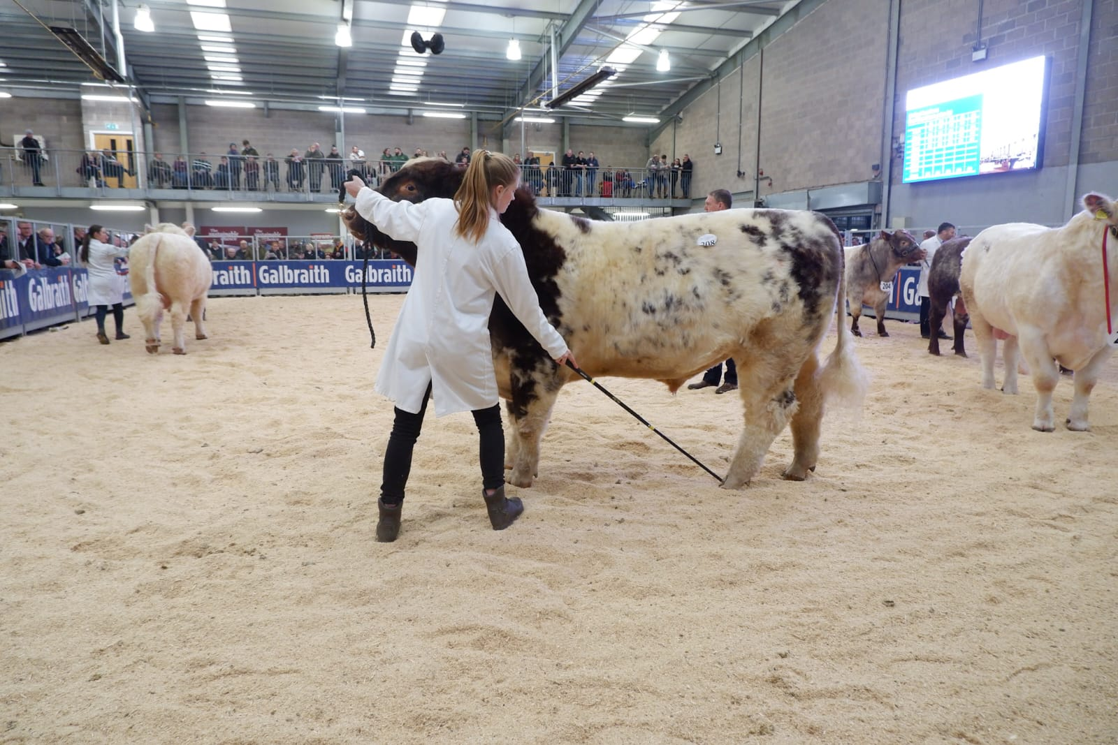
The bulls are encouraged with a split ended stick to stand square by pushing their feet into a better position while making sure to hold up their heads.

Slide 27
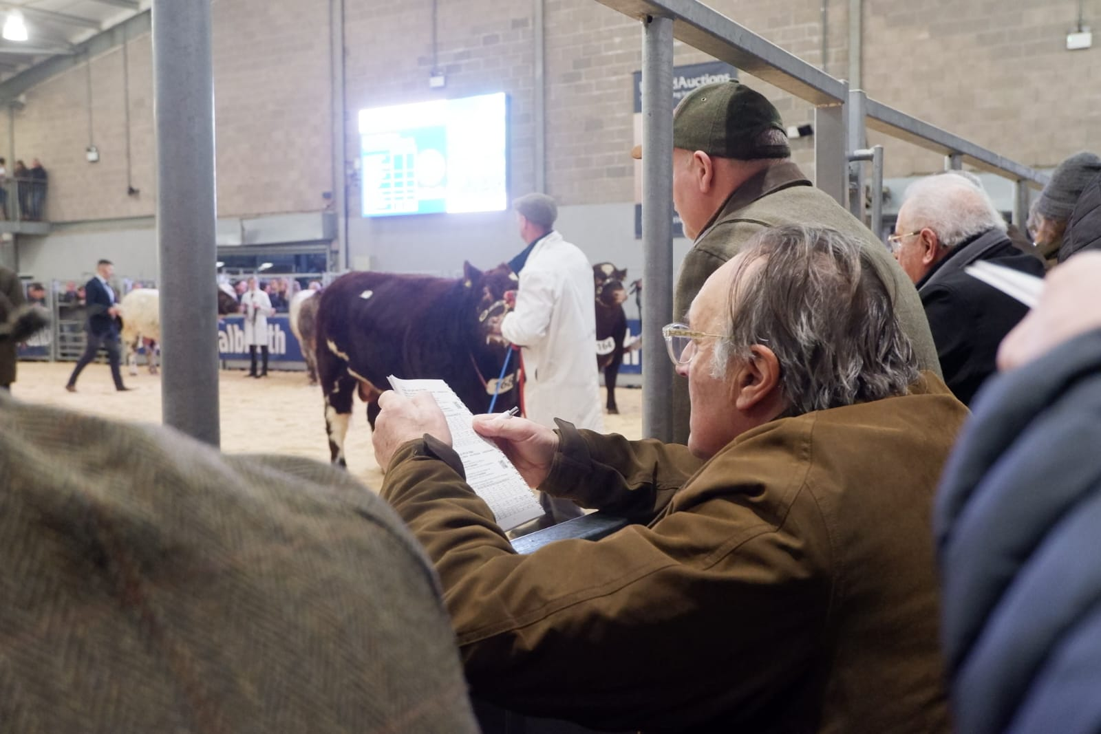
The spectators consult their catalogues throughout the class for full information on the breeding and statistics of each bull. The judge does not see the catalogue in advance of the show.

Slide 28
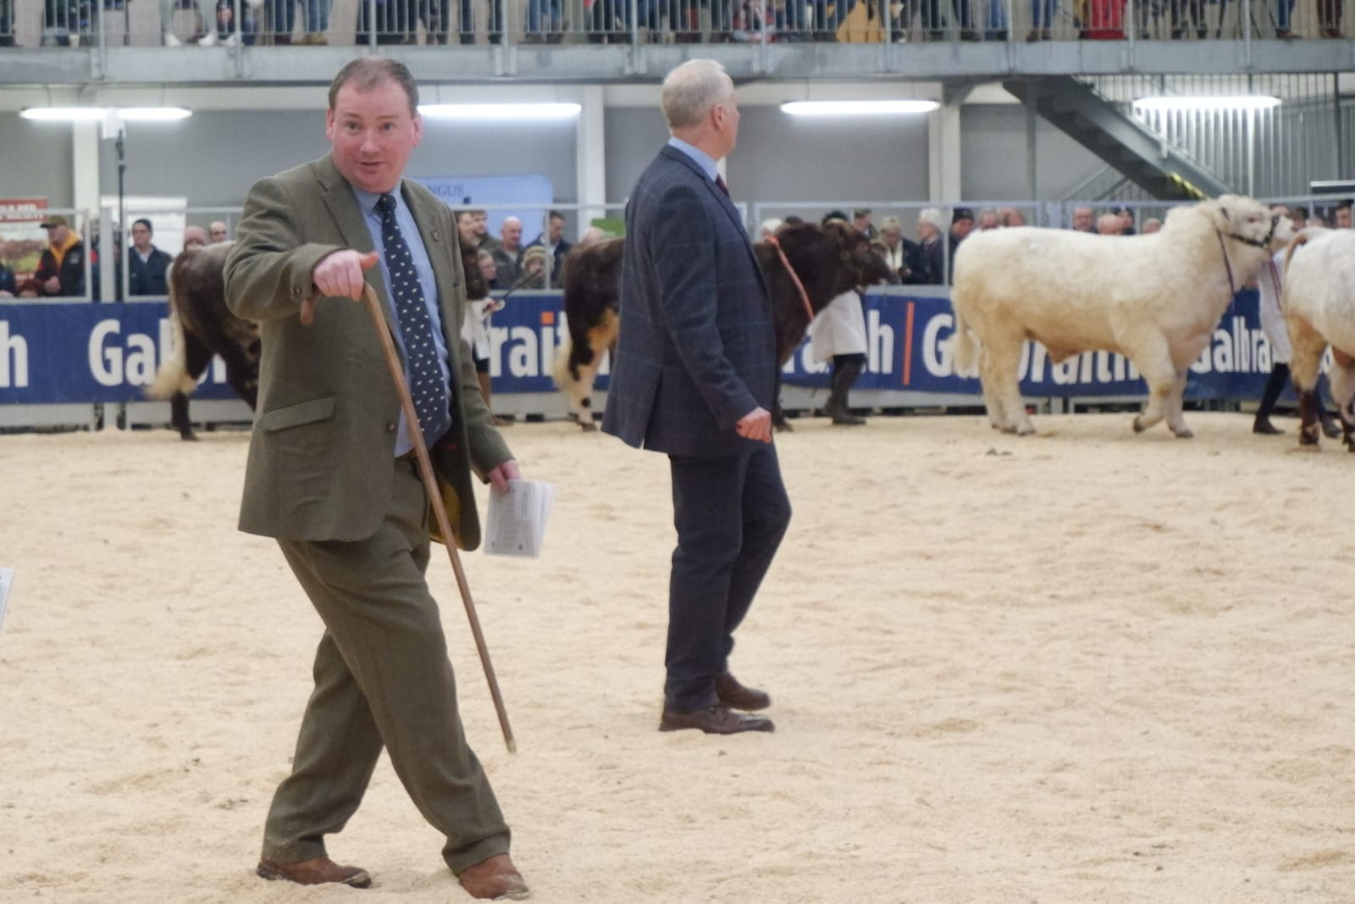
The auctioneer for the following day’s sale of each breed is present throughout the show proceedings. He is signaling to a handler who has not seen the judge pull him in.

Slide 29
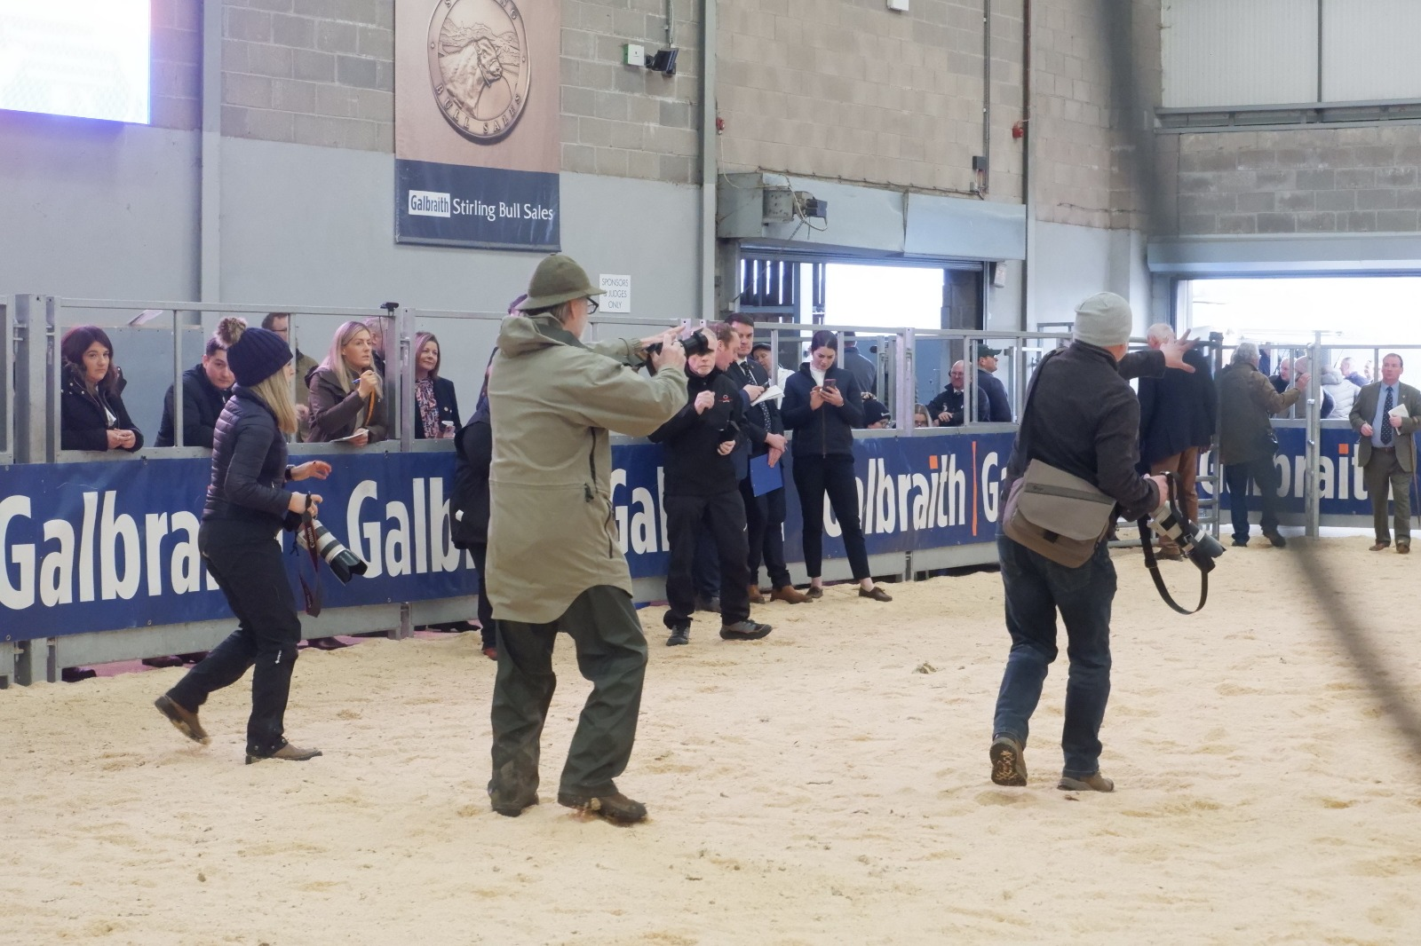
Photographers from the farming press rush forward when the winner of the class is chosen.

Slide 30
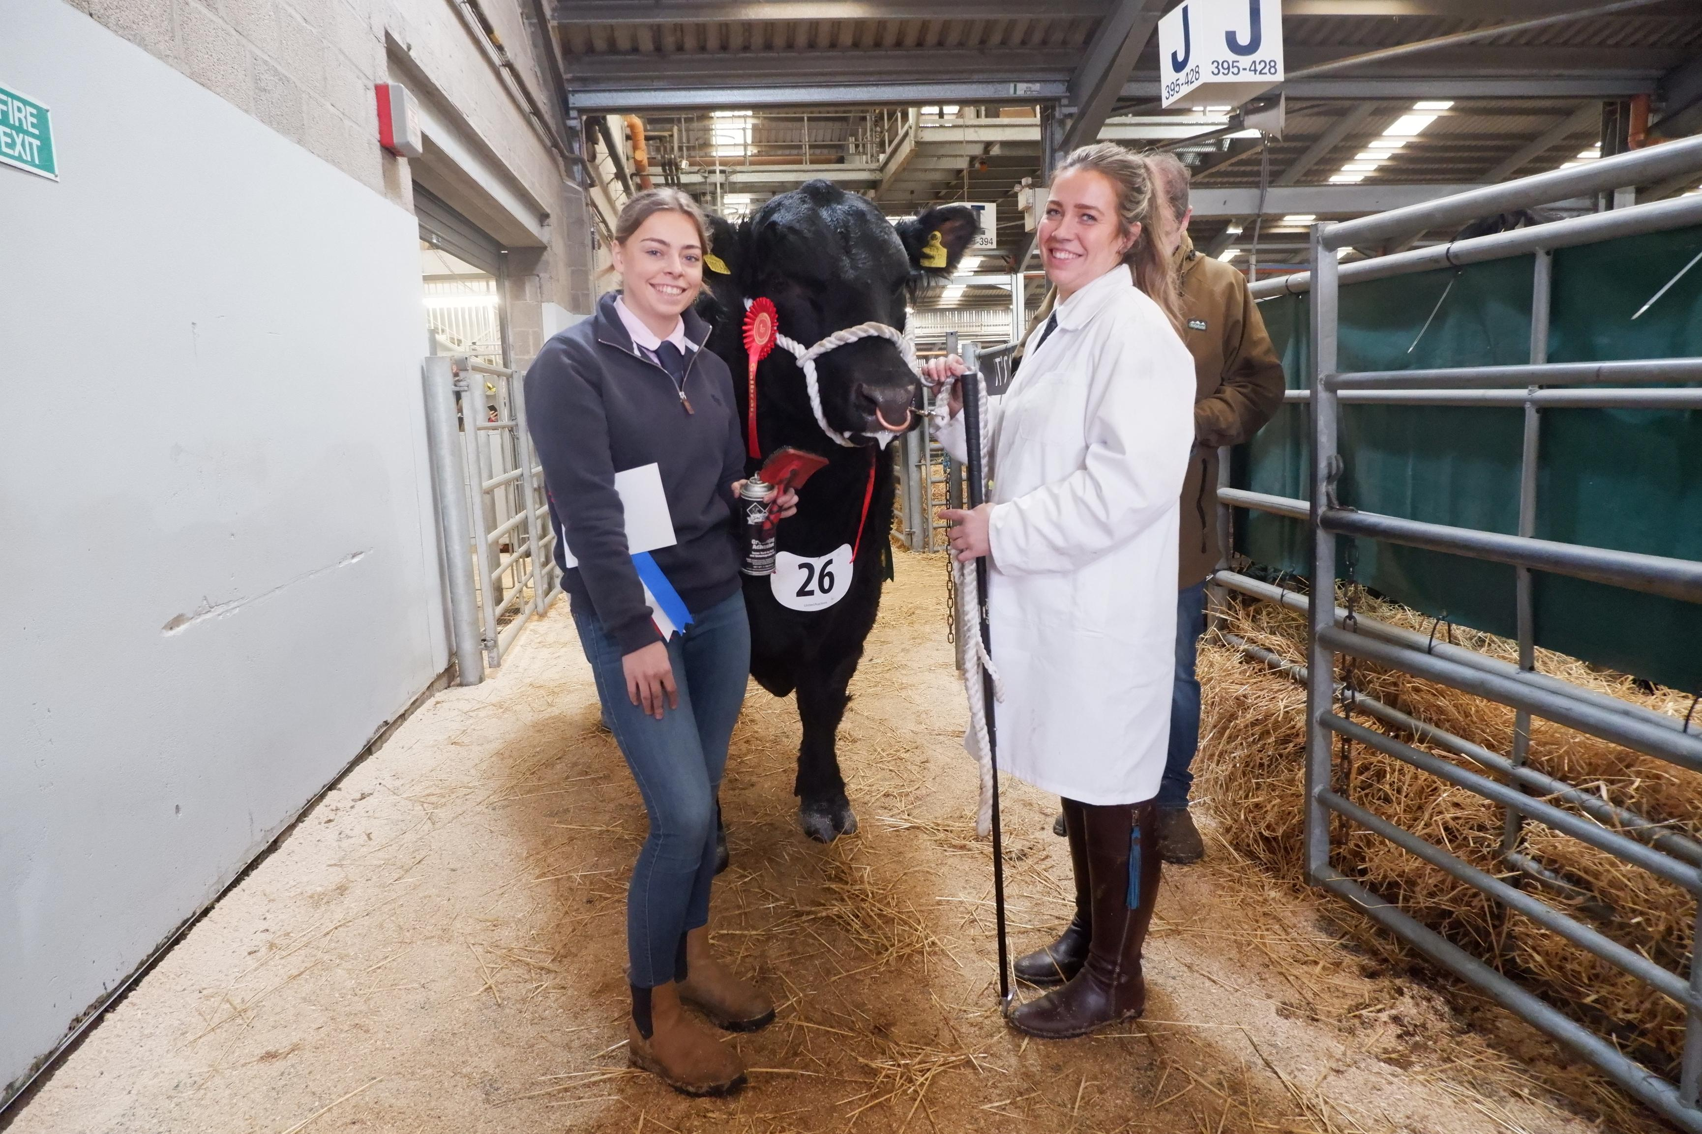
Winners but not overall Aberdeen Angus champions

Slide 31
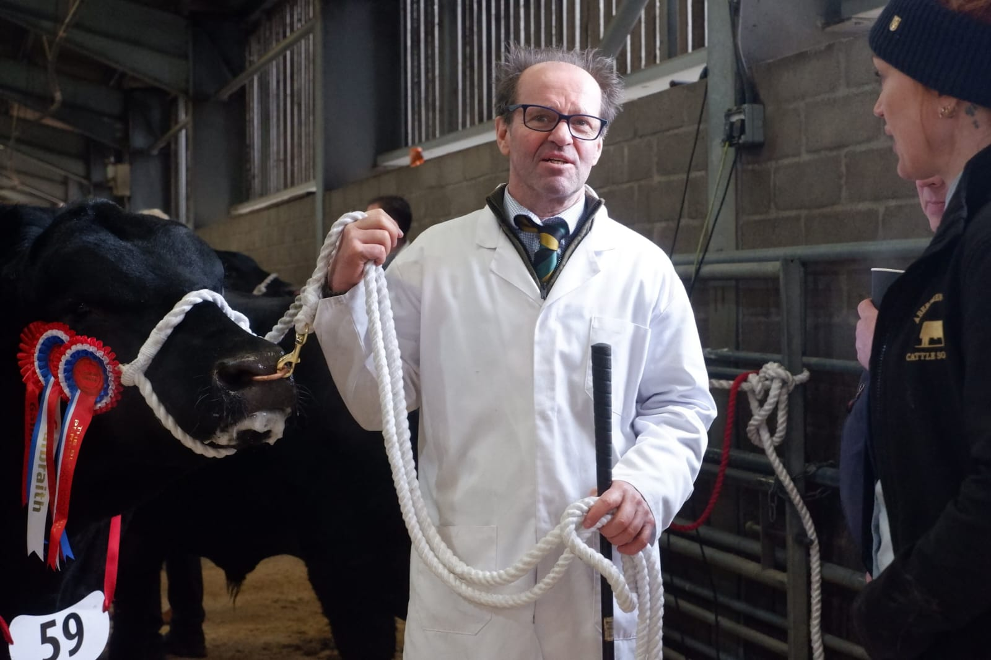
Festooned with rosettes, this Aberdeen Angus bull is the Champion.

Slide 32
Part 4
How to Choose a Champion

Slide 33
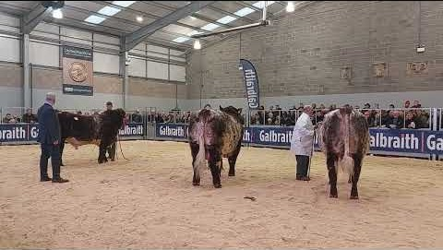
This is the culmination of the show. The judge must now pick the overall Champion and the Reserve Champion from the three he chose as winners of their age class. This video is 5 minutes 52 seconds long. It is unedited.

Slide 34
Part 3
The Beef Shorthorn Champion Prizegiving

Slide 35
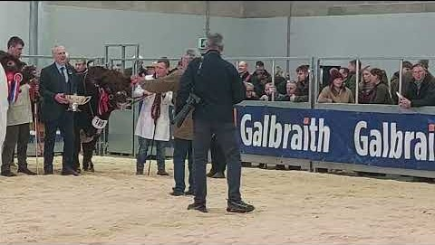
The silver cups are displayed with the winners immediately the winners are announced, for the benefit of the photographers and the audience and will be taken back to be re-presented more formally at the Society’s dinner later in the evening.
https://www.youtube.com/watch?v=eESre4Hhtmw

